Slide 1

1st Grade Rules
And
Procedures
Mrs. High
Grade level: 1st
Room #126
Notes:
Page numbers correlate with Harry Wong’s The First Days of School.

Slide 2
Everything You Need to Know for a Successful Arrival
Unpack
Homework/planner/notes
Please sit
Bell Work
Notes:
Have the bell work up on the board first thing day one. Have a simple way to greet students at the door, find their cubby, desk and begin work while you greet other students as they arrive. Everyday you should be outside of your door greeting students. Each day from here after, students should enter the room in an orderly fashion, put away their materials and begin the bell work.

Slide 3
Am I in the right room?
Did you see your name by the door?
Did you see Mrs. High’s name outside the door?
I will greet you at the door.
Notes:
Pages 105-107/ Post the first names of all students outside your room. Be sure to be outside of your classroom the first day and everyday before the students enter. The teacher should have a list of names on a clipboard to greet all students by name and tell them where to sit as they enter. Remember that all students at Patriot are under your watch. If a child comes up the wrong stairwell or is misbehaving in the halls it is up to you, the adult who witnesses the behavior to correct it quickly and firmly. If you let it go students will think it is acceptable to choose behaviors that differ from our expectations. It is important to have a seating plan for each student the first day of school. Have assigned student seats. You may do this several ways, see the first days of school p. 106-107

Slide 4
Where do I sit?
Sit at the desk with your name.
Notes:
Pages 105, 108,110, 116-120. It is important to have your room set up for optimal learning.

Slide 5
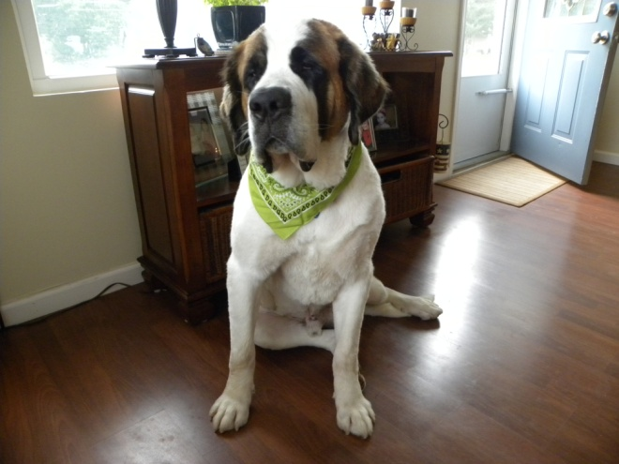
Who is my teacher?
My name is Mrs. High.
I have been teaching for 3 years.
I have my Master’s Degree in Elementary Education.
I have one dog named Bear.
I love to teach, to swim, and to read!
I know this will be a fantastic year!
Notes:
p. 105 p.109 Look for ideas: It is a good idea to introduce yourself to your students on the first day of school.

Slide 6
Will this teacher treat me fairly?
YES,
ALWAYS!
Notes:
p.105 This slide might not be necessary/appropriate for primary classrooms, but might be a good discussion starter as you move toward making classroom mission and vision statements. This statement is very true, but be assured that your idea of fair and a student’s idea of fair will most likely never match.

Slide 7


Mrs. High’s Classroom
Guidelines
Rules
Procedures
Notes:
The guidelines and procedures help your students get to work. The procedures your students practice the first two weeks will help you teach content the rest of the year. Remember procedures and routines are the doing. Model procedures, rehearse and practice over and over.

Slide 8
What are the rules in this classroom?
I will raise my hand to talk.
I will be nice to others.
I will listen and follow directions.
I will do my best!
Notes:
p. 105,152,160,161/ The fewer the rules the better. Set rules that you can live with and that coincide with Patriot School rules and regulations. Remember that a student who is not following a rule should be quickly and firmly reminded of correct behavior. We are all responsible for all of the students in our school. ( P.141-191 The First Days of School) Harry Wong says a rule is a DARE to be broken. Try not to have too many rules. Discipline gets students to stop. Procedures get students to do. Go over all rules the first two weeks, make sure that your students understand each of your classroom rules, and follow them.

Slide 9
Behavior
Color | Consequence
Green | Good Job
Yellow | Warning
Orange | Time Out
Red | Time Out in another room

Slide 10

Guideline #1
Be in your assigned seat and working on the assigned Bell Work when the tardy bell rings.
Notes:
Have Bell work on the board at the beginning of each day, and it should be in the same place. If you are absent you should have the Bell Work available for the substitute. Bell Work should be meaningful work, work that engages students, a review of the past days work, a writing prompt, or questions that stimulates thinking, and engages students. It is best if grade levels plan Bell work together. Practice this routine.

Slide 11
Entering The Room
Please enter quietly & unpack
Have a seat
Take out your materials
Put your materials in the assigned spot
Eat your breakfast
Begin bell work assignment
Notes:
P.

Slide 12
Example of Morning Bellwork
Bellwork: Do morning message & write in your morning journal.
Bellwork will be posted on the board or left out at your seat.
Notes:
Example of Bell Work.

Slide 13


Guideline #2
Bring all books and materials to class.
Bring your planner to class each day signed by your parent.
Bring your AR books to school.
Notes:
What are your guidelines? They should be evident and posted, students should be aware of guidelines. Send a list of expected guidelines home for parents to look at and sign. If a child doesn’t have materials don’t make it comfortable, no pencil, give him/her a golf pencil to use until they bring one in.

Slide 14
Guideline #3
Follow directions the first time they are given.
Notes:
How will you ensure that you don’t waste time repeating yourself over and over? Go over this with students. Let your class know that you expect students to listen, there isn’t much time in the day and there is a lot to accomplish.

Slide 15

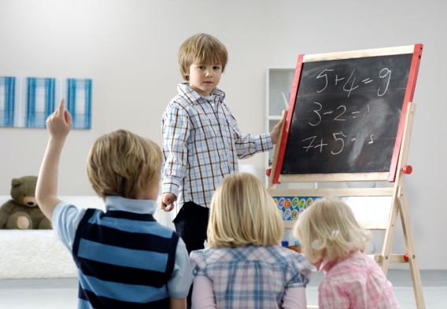
Moving Around the Room
You must ask permission during lessons.
You may get a drink or use the restroom anytime during bell work and centers.
Do not ask during a classroom discussion unless it is an emergency.
Notes:
Students should not get up during the time you are presenting a lesson or during class discussions. If a child seems to be having a lot of “bathroom” emergencies a phone call home would be a good idea. Explain to students that it is important that everyone hears the class discussion and directions.

Slide 16
Guideline #4
Treat each person in the room with respect and dignity.
Notes:
Practice this guideline: What is dignity? (define) What does dignity look like? (have students give examples) What it isn’t? Frayer Model- Have students come up with ideas, post it in the classroom and send it home.

Slide 17
Guideline # 5
Follow all of the procedures and policies as outlined in the Lee County Schools Student Handbook.
Notes:
Go over the handbook with the students. As a grade level go over specific pages on certain days of the week. You may need more than one slide for this. This is a catch all guideline. If you have forgotten something it is in the district handbook.

Slide 18
Special Guideline
This classroom is a “No Whining Zone”.
That means that there will be no whining, for any reason.
Everything that I do is in your best interest, so please . . . Respect the “No Whining Zone” this year.

Slide 19
Severe Clause
Any student who uses profanity, fights, damages school property (this includes the property of the teacher and other students), or is disrespectful (as defined by the teacher) will be sent to the office IMMEDIATELY.
Notes:
Go over specifically what this means. Disrespectful means ( write this up with your team) be specific so students know what is expected.

Slide 20
Classroom Procedures
Explain
Practice
Reinforce
Notes:
p. 174, 167-194 It is important to explain, rehearse and reinforce all of the procedures that your student’s should know. Begin the week with a few simple procedures and add to the list as the procedures are needed, an example would be walking down the hall to special classes, lunch or PEB. A procedure that can be practiced later during week two would be fire drill or school lockdown procedures. No matter what procedure you are teaching always, explain, rehearse and reinforce. Procedures are the “how to”.

Slide 21
When You Are Tardy
  Enter quietly & unpack.
  Place Tardy notice in the mail pail.
  Have a seat and take out materials .
Notes:
What is your procedure for a tardy student?

Slide 22
Getting Your Attention
I will:
Stand in front of the class
Raise my hand and say “Freeze Please”
Wait for everyone to be quiet
Begin speaking
Notes:
p.181 Raising your hand will be a signal used throughout Patriot Elementary School. In the primary grades teachers may start with give me five or whatever chant you use, but your hand should still be raised.

Slide 23

Classroom Discussions
Please participate
I want to hear what you have to say.
Raise your hand before speaking.

Slide 24
Finish Class Work Early?
What Do I Do???

Slide 25
What Do I Do Next Activities?
Read an AR book
Take an AR test
Finish other work
Write a letter
Write a story
Notes:
p.170 Come up with a list of ideas that work for your class. Don’t make the activities busy work, but also don’t make them so much fun that a student will hurry through their work to get to the “Next Best” thing. Meaningful anchor activities should be posted.

Slide 26
Paper Heading
In the left hand corner of all papers:
  Print your Name
  Print the Date
Notes:
School wide format will be shown to all students and used throughout the school.

Slide 27
Example of Paper Heading
Joe Smith
August 23, 2010

Slide 28
Turning In Papers
Check to be sure you wrote your name and the date.
Check to be sure your paper is complete.
Check to be sure your paper is neat.
Turn papers in to the basket.
Notes:
Put the procedure that you want to use in your class. Remember that having one person pick up and or handout papers takes time. Try to come up with a system that is quick an easy and doable all year.

Slide 29
After An Absence
Your make-up work will be placed in your homework folder.
Notes:
Add grade level procedure for late work. This is an example but may not work well for elementary students.

Slide 30
Special Procedures
These will be introduced on an “as needed” basis.
Library/ Media Center
Computer Lab
Special Guests
Assemblies
Progress Reports
Working Cooperatively
Fire Drill
Tornado Drills
Intercom Announcements
Substitute teacher
Notes:
Look through the staff handbook and find the procedures for fire drill, tornado drills and lockdown procedures and add them to your grade level PowerPoint. Come up with substitute teacher plans so that your class knows what is expected if you are absent.

Slide 31
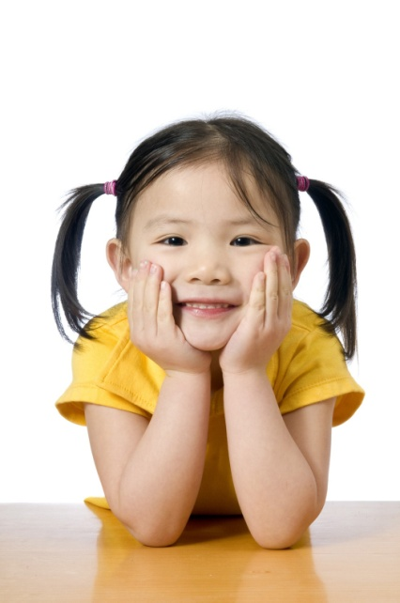
Remember
I truly believe in your potential and I want you to believe in it too!
Have an Awesome Year!
Mrs. High

